Slide 1
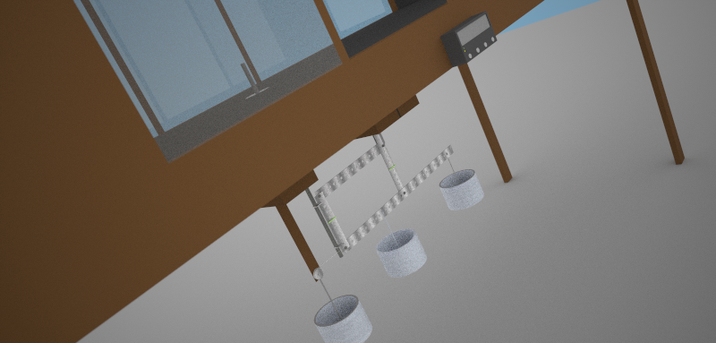




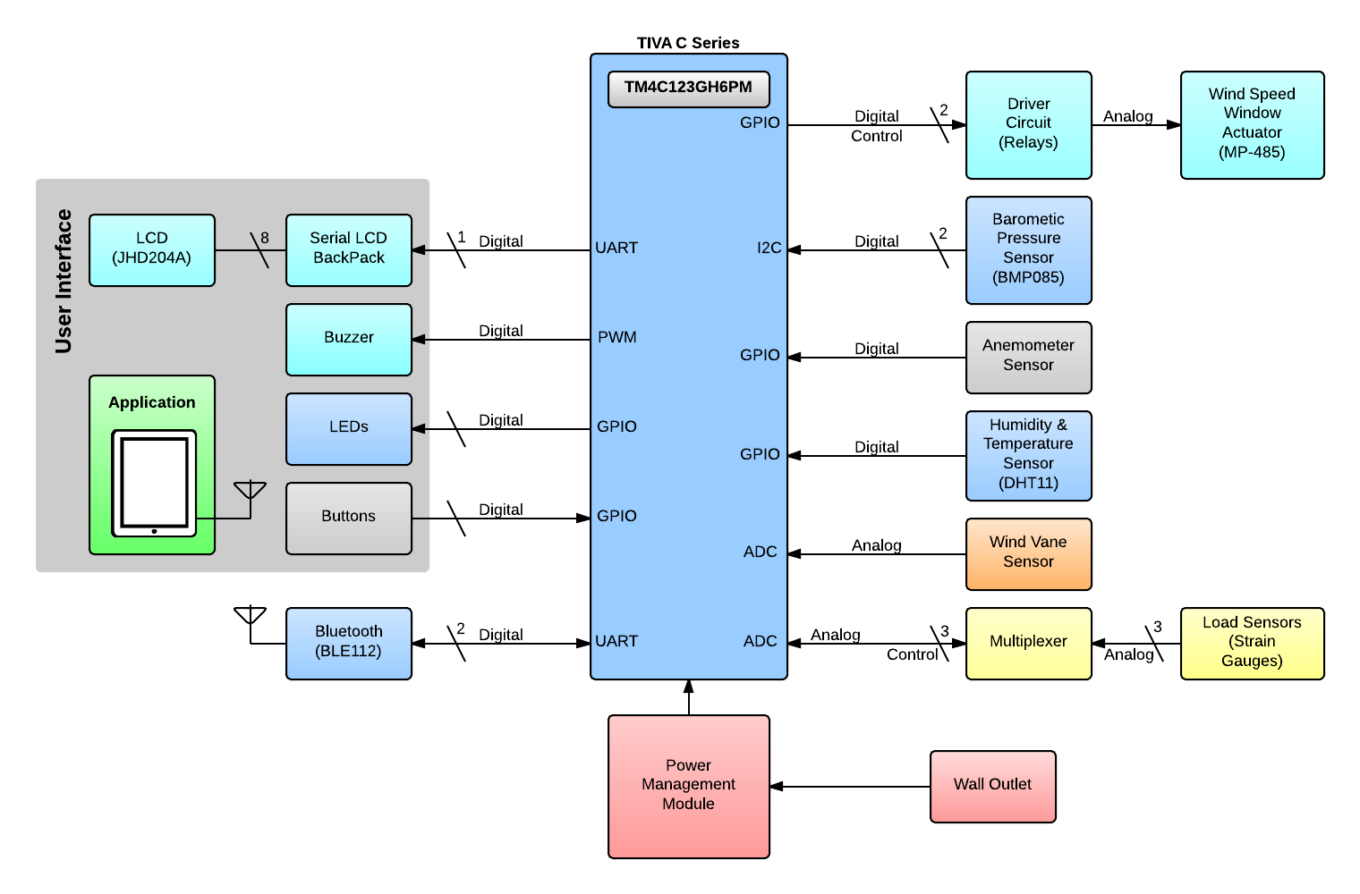

Team Members:
Description
The wind tunnel in the Department of the Civil Engineering at UPRM was made over 30 years ago and is used to measure aerodynamic properties acting on objects such as cars, helmets, or airplane wings, to increase their aerodynamic efficiency. To obtain these, the tunnel uses a balance that measures drag, and lift forces. The tunnel consists of various parts that are outdated which require manual intervention to run the experiments. AeroBal brings the wind tunnel to the 21st century by adding sensors, automatization of processes, connectivity, accuracy, and reliability running along a powerful TM4C ARM Cortex-M4 processor. It is a system focused on automatization of a wind tunnel’s operation, centering on the balance used to measure the active forces on the sample object.
AeroBal uses strain gauge sensors to accurately detect the forces exerted by the wind current. An LCD screen and buttons function as the primary interface for controlling the system and displaying data in real time, which allows users to easily see experimentation data. To add extra ease, users are able to connect through bluetooth to a mobile application which permits convenient control of the system and the ability to read the data from the comfort of their tablets. AeroBal’s purpose is to increase the ease, effectivity, and productivity of research being done in the tunnel which would also enable new research to be done.
Anthony Llanos
Juan Lebrón
Jesus Luzon
Jean Méndez

